Slide 1
Bansal College of Engineering
BusEasy
Project Topic
Bus Ticket
Management System
SUBMITTED BY -
SUBMITTED TO -
Mohit Kumar Patel 0127CS211050
Chetan Doniwal 0127CS211024
Akshat Shukla 0127CS211008
Neelam Janyani 0127CS211053
Dr. Kusum Lata

Slide 2
BusEasy
A Bus Ticket Management
System Web Application

Slide 3
Index
Introduction
Objective
Planning
Requirements Analysis
Technology Used
ER Diagram
Data Flow Diagram
​Outcome
​Summary​

Slide 4
Introduction
BusEasy is the minor project which aims to developing a website system to maintain all the information about the bus and tickets.
It helps to store the data of the buses available, their passengers, and the tickets of the passengers.

Slide 5
Objective
The objective of BusEasy, is to simplify and smooth the process of booking bus tickets for passengers
Also providing efficient management tools for bus operators.

Slide 6
Requirement Analysis
User Management
Bus Booking and Reservation
Payment Processing
Ticket Confirmation and Generation
Ticket Modification and Cancellation
Bus Operator Interface

Slide 7



Technology Used
Front-End
Back-End
Database
HTML5
CSS3
JavaScript
Node JS
Express JS
Mongoose
MongoDB

Slide 8
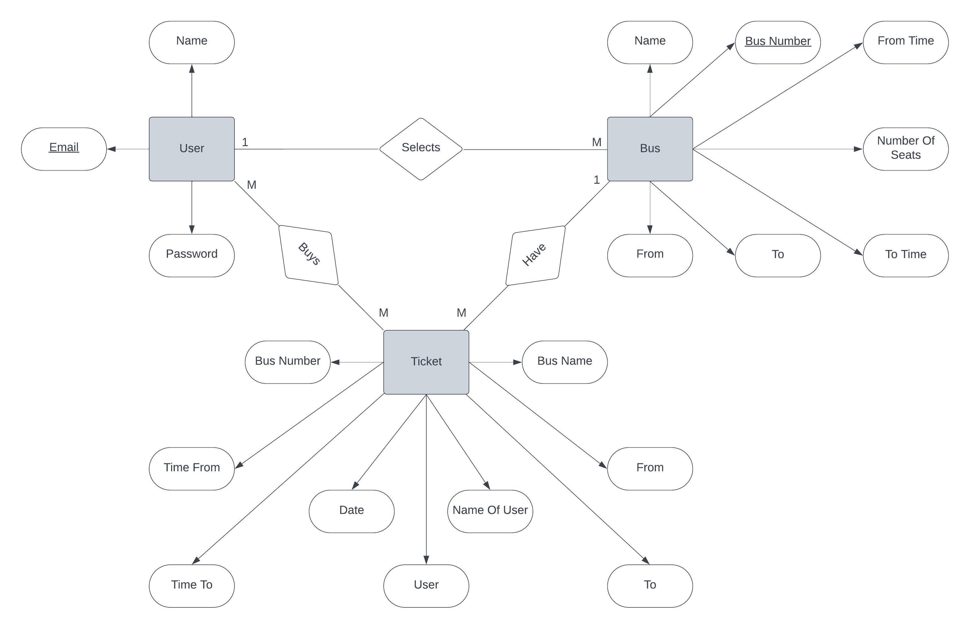
ER Model

Slide 9
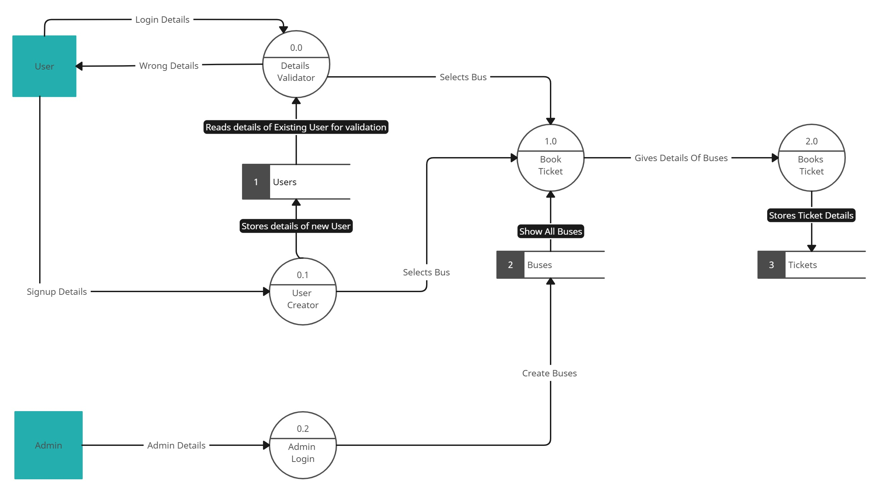
DATA FLOW DIAGRAM

Slide 10
summary
In summary, a bus ticket management system web application enhances the bus ticket booking process for passengers, smooth operations for bus operators, and provides administrators with tools to monitor and manage the system effectively.
It offers convenience, security, and efficiency in the bus transportation industry while promoting a user-friendly and sustainable ticketing experience.

Slide 11
References
Studocu - https://www.studocu.com/in
GeeksForGeeks - https://www.geeksforgeeks.org/how-to-design-runtime-generated-pdf-via-html/
W3schools - www.w3schools.com

Slide 12
THANK YOU
Mohit patel
0127cs211050
Akshat Shukla
0127CS211008
Chetan Doniwal
Neelam Janyani
0127CS211024
0127CS211053

